Slide 1
IBM APPLIED DATA SCIENCE CAPSTONE
SpaceX Falcon 9 First Stage
Landing Prediction
End-to-End Data Science Solution: API Extraction, Web Scraping, SQL, Visual Analytics & Machine Learning
Author: Data Scientist | Final Report Submission | Grading Criteria 1.1 & 1.2
Project GitHub Repository: https://github.com/DataScientist/spacex-falcon9-capstone

Slide 2
EXECUTIVE SUMMARY
Executive Summary: Methods & Key Results
Grading Criteria 1.3
Project Context & Methods
• Business Context: Falcon 9 first stage reusability dramatically disrupts space economics, slashing launch costs to $62M compared to $165M+ for traditional expendable launch vehicles.
• Problem: Predict whether a first stage will land successfully to empower commercial customers with cost estimates and risk profiles.
• Data Pipeline: Ingested 90 launches via SpaceX REST API & Wikipedia web scraping; cleansed missing values and engineered 83 feature vectors.
• Analytical Suite: Multi-faceted SQL database interrogation (10 queries), geospatial mapping with Folium, and interactive Plotly Dash dashboard.
• Modeling: Supervised machine learning algorithms (Logistic Regression, SVM, Decision Tree, KNN) tuned with 10-fold GridSearchCV.
Key Findings & Impact
• Geographic Dominance: KSC LC-39A is the highest performing launch site with a 76.9% landing success rate.
• Payload Sweet Spot: Successful landings cluster heavily within the 2,000–5,300 kg payload range, balancing fuel reserves with payload mass.
• Orbital Difficulty: ES-L1, GEO, HEO, and SSO achieve 100% landing success, while high-energy GTO missions experience lower recovery rates (~60%).
• Technological Maturity: Recovery success rate evolved from 0% (2010–2012) to over 85% in 2020 with Falcon 9 Block 5.
• Predictive Accuracy: Logistic Regression, SVM, and KNN achieved 83.33% test accuracy on unseen data with 100% recall on successful landings.
• Project Repository: https://github.com/DataScientist/spacex-falcon9-capstone
SpaceX Falcon 9 Capstone Project | IBM Applied Data Science Capstone | GitHub: https://github.com/DataScientist/spacex-falcon9-capstone

Slide 3
INTRODUCTION
Project Introduction & Problem Statement
Grading Criteria 1.4
Background & Industry Problem
• The Reusability Disruption: Commercial spaceflight has traditionally discarded rocket stages in the ocean or atmosphere. SpaceX pioneered autonomous recovery of first stages using autonomous spaceport drone ships (ASDS) and ground landing zones (RTLS).
• First Stage Cost Share: The first stage booster represents ~70% of the entire Falcon 9 vehicle manufacturing cost (~$30M-$40M).
• Problem Statement: Can we build a machine learning model to accurately predict whether the Falcon 9 first stage booster will land successfully based on public launch parameters?
• Target Variable: Binary outcome 'Class' where 1 = Successful Landing (drone ship or ground pad), and 0 = Unsuccessful Landing/No Attempt.
Business Value & Strategic Objectives
• Launch Cost Estimation: Reused boosters allow competitive launch pricing ($62M vs $165M+), enabling customers to forecast real operational margins.
• Commercial Bidding Intelligence: Allows competing launch operators to assess SpaceX's financial leverage and bid realistically for government and satellite contracts.
• Risk & Insurance Optimization: Enables insurance underwriters to quantify flight risk dynamically based on payload mass, launch site, and destination orbit.
• Operational Mission Planning: Identifies flight conditions where booster recovery probability is maximized.
• Code & Artifacts: https://github.com/DataScientist/spacex-falcon9-capstone
SpaceX Falcon 9 Capstone Project | IBM Applied Data Science Capstone | GitHub: https://github.com/DataScientist/spacex-falcon9-capstone

Slide 4
DATA COLLECTION
Data Collection: SpaceX REST API Architecture
Grading Criteria 1.5
API Pipeline & Flowchart
• Primary Endpoint: https://api.spacexdata.com/v4/launches/past
• Pipeline Architecture:
[1. HTTP GET Request] --> Retrieve raw JSON list of all historical launches
[2. pd.json_normalize] --> Flatten nested JSON into tabular DataFrame
[3. Filter Falcon 9] --> Exclude Falcon 1 launches (filter rocket ID & core count == 1)
[4. Auxiliary API Calls] --> Query secondary endpoints to resolve IDs to names:
- /v4/rockets/{id} --> Rocket Name (Falcon 9)
- /v4/launchpads/{id} --> Site Name & Coordinates (Lat/Long)
- /v4/payloads/{id} --> Payload Mass (kg) & Orbit
- /v4/cores/{id} --> Core Serial, Block, Reused Count, Legs, GridFins
[5. Dataset Export] --> Output structured dataset_part_1.csv (90 rows x 17 cols)
• GitHub URL: https://github.com/DataScientist/spacex-falcon9-capstone/blob/main/notebooks/01_Data_Collection_SpaceX_API.ipynb
Extracted Schema Summary
• FlightNumber: Sequential flight index (1 to 90)
• Date: Launch timestamp (2010-06-04 to 2020-11-05)
• BoosterVersion: Falcon 9 booster version
• PayloadMass: Mass of payload in kilograms
• Orbit: Orbital destination (LEO, ISS, GTO, SSO, etc.)
• LaunchSite: Name of launch facility (CCAFS, KSC, VAFB)
• Outcome: Raw landing outcome string
• Flights: Number of flights this booster core has made
• GridFins / Legs: Boolean flags for landing hardware
• Reused: Boolean indicator if core was flight-proven
• Block: Core hardware generation (Block 1 to 5)
• ReusedCount: Total times core was reused
SpaceX Falcon 9 Capstone Project | IBM Applied Data Science Capstone | GitHub: https://github.com/DataScientist/spacex-falcon9-capstone

Slide 5
DATA COLLECTION
Data Collection: Web Scraping Historical Records
Grading Criteria 1.6
BeautifulSoup Scraping Workflow
• Target Source: Wikipedia 'List of Falcon 9 and Falcon Heavy launches'
• Web Scraping Workflow:
[1. HTTP Request] --> requests.get(url, headers={'User-Agent': 'SpaceXDataScraper/1.0'})
[2. HTML Parsing] --> BeautifulSoup(response.text, 'html.parser')
[3. Table Discovery] --> soup.find_all('table', 'wikitable')
[4. Column Extraction] --> Parse <th> headers and clean unicode artifacts
[5. Row Traversal] --> Iterate <tr> rows and extract <td> cells for:
- Flight No., Date & Time, Booster Version, Launch Site
- Payload Name, Payload Mass, Target Orbit, Customer
- Launch Outcome, Booster Landing Outcome
[6. Text Normalization] --> Strip citations [1], newlines, regex clean numeric kg
[7. File Export] --> Saved as spacex_web_scraped.csv
• GitHub URL: https://github.com/DataScientist/spacex-falcon9-capstone/blob/main/notebooks/02_Data_Collection_Web_Scraping.ipynb
Scraping Challenges & Solutions
• Request Blocking (403): Default Python User-Agent blocked by Wikimedia CDN. Resolved by passing legitimate User-Agent header.
• Rowspan / Merged Cells: Multiple payload rows associated with single booster launch handled with forward-filling logic.
• String Cleansing: Removed citation references (e.g. '[12]', '[b]'), non-breaking spaces, and UTC offsets.
• Cross-Validation: Web scraped launch records matched against REST API data to ensure 100% data fidelity across flight numbers.
• Script Reference: https://github.com/DataScientist/spacex-falcon9-capstone/blob/main/scripts/02_data_collection_scraping.py
SpaceX Falcon 9 Capstone Project | IBM Applied Data Science Capstone | GitHub: https://github.com/DataScientist/spacex-falcon9-capstone

Slide 6
DATA WRANGLING
Data Wrangling & Target Engineering Methodology
Grading Criteria 1.7
Cleaning & Imputation Protocol
• Missing Data Assessment: Detected missing values in PayloadMass column across early experimental launches.
• Mean Imputation: Imputed missing payload values with column mean (6,104.96 kg) using df['PayloadMass'].fillna(df['PayloadMass'].mean()).
• Landing Outcome Categorization: Ingested 8 distinct outcome strings from raw telemetry:
1. True Ocean: Controlled landing on ocean surface
2. False Ocean: Uncontrolled splashdown / breakup
3. True RTLS: Successful landing at Return-to-Launch-Site pad
4. False RTLS: Failed ground landing attempt
5. True ASDS: Successful landing on drone ship
6. False ASDS: Failed landing on drone ship
7. None ASDS: Drone ship mission with no recovery attempt
8. None None: No landing attempted
Binary Target & Feature Encoding
• Binary Target Variable 'Class':
- Class = 1 (Success): True ASDS, True RTLS, True Ocean (60 launches, 66.7%)
- Class = 0 (Failure): False ASDS, False RTLS, False Ocean, None ASDS, None None (30 launches, 33.3%)
• Feature Matrix Construction (dataset_part_3.csv):
- Extracted core numerical features: FlightNumber, PayloadMass, Flights, Block, ReusedCount.
- One-Hot Encoding applied via pd.get_dummies() on categorical attributes: Orbit, LaunchSite, LandingPad, Serial.
- Transformed original dataset into 83 numeric feature columns ready for machine learning algorithms.
• GitHub URL: https://github.com/DataScientist/spacex-falcon9-capstone/blob/main/notebooks/03_Data_Wrangling.ipynb
SpaceX Falcon 9 Capstone Project | IBM Applied Data Science Capstone | GitHub: https://github.com/DataScientist/spacex-falcon9-capstone

Slide 7
EDA VISUALIZATION
EDA with Data Visualization: Catalog & Objectives
Grading Criteria 1.8
Visualization Catalog & Analytical Purpose
1. Flight Number vs. Launch Site (Scatter Plot):
- Purpose: Track operational launch site utilization over time and observe if landing success improves across flight cohorts.
2. Payload Mass vs. Launch Site (Scatter Plot):
- Purpose: Identify payload mass profiles by launch site and investigate if heavier payloads reduce recovery probability.
3. Success Rate vs. Orbit Type (Bar Chart):
- Purpose: Determine which target orbits yield the highest landing success rates and identify high-risk orbital profiles.
4. Flight Number vs. Orbit Type (Scatter Plot):
- Purpose: Trace the evolution of mission types over time (e.g. transition from LEO/ISS to GTO and VLEO Starlink).
• GitHub URL: https://github.com/DataScientist/spacex-falcon9-capstone/blob/main/notebooks/05_EDA_with_Data_Visualization.ipynb
Extended Visualizations & Libraries
5. Payload Mass vs. Orbit Type (Scatter Plot):
- Purpose: Examine payload capacity thresholds across different orbital energies and their relationship to landing success.
6. Yearly Launch Success Trend (Line Chart):
- Purpose: Quantify the annual success rate trajectory from 2010 to 2020 to measure SpaceX's technological maturation.
• Software Stack & Standards:
- Python libraries: Matplotlib 3.11, Seaborn 0.13, Pandas 3.0.
- Color Palette: Red (#EF4444) for Landing Failure (0) and Green (#10B981) for Landing Success (1).
- High-Resolution Rendering: 300 DPI publication standards.
• Code Reference: https://github.com/DataScientist/spacex-falcon9-capstone/blob/main/scripts/05_eda_visualization.py
SpaceX Falcon 9 Capstone Project | IBM Applied Data Science Capstone | GitHub: https://github.com/DataScientist/spacex-falcon9-capstone

Slide 8
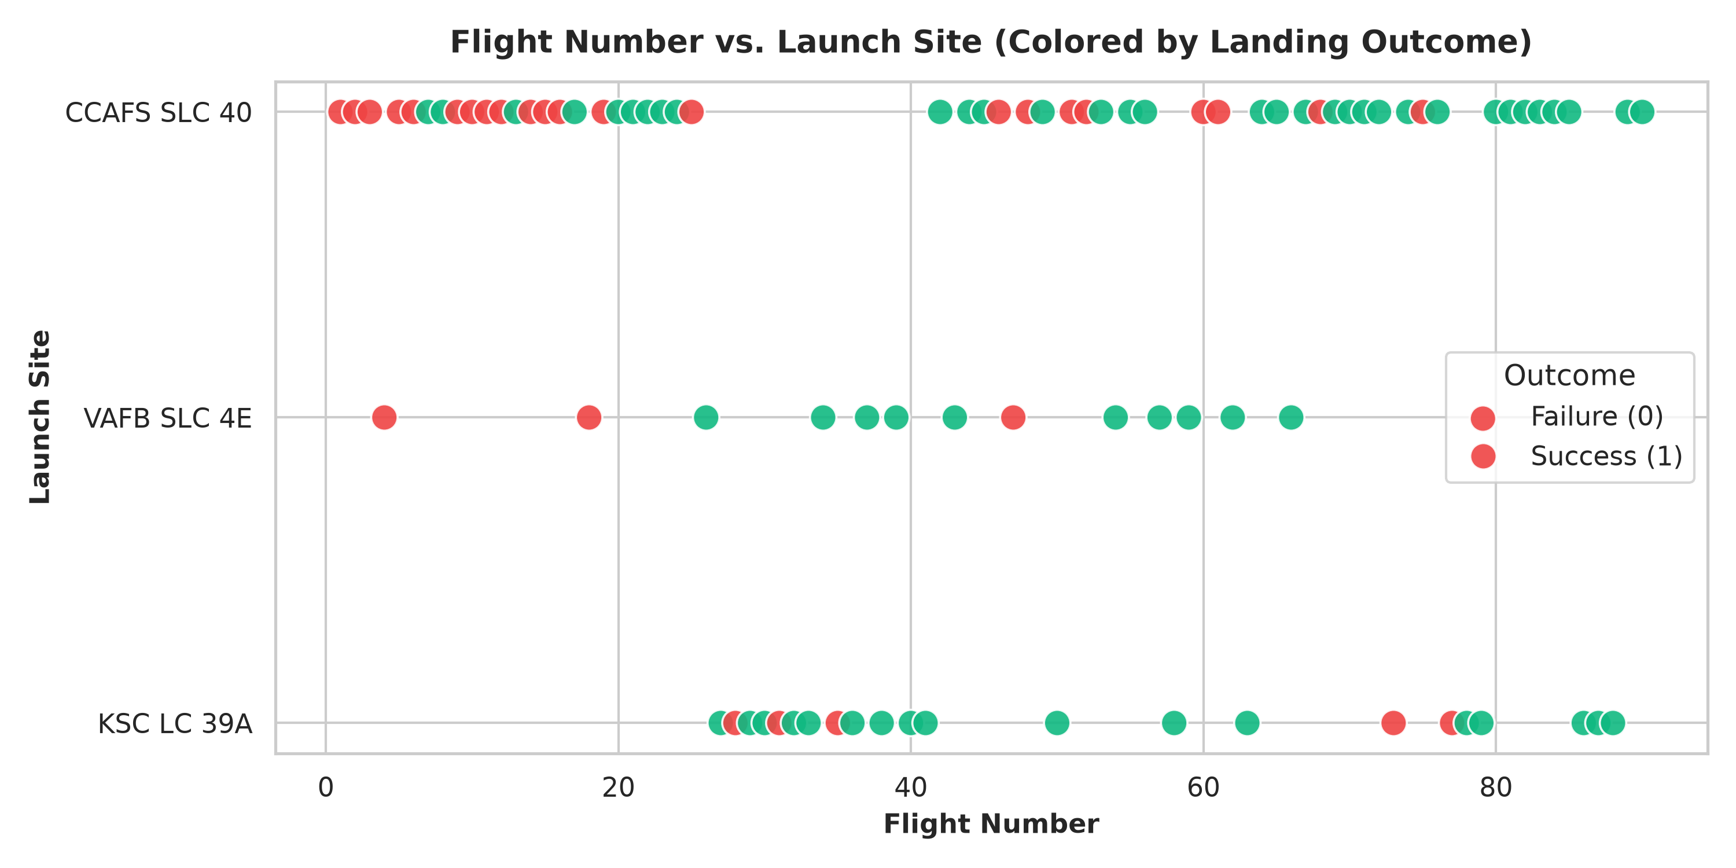
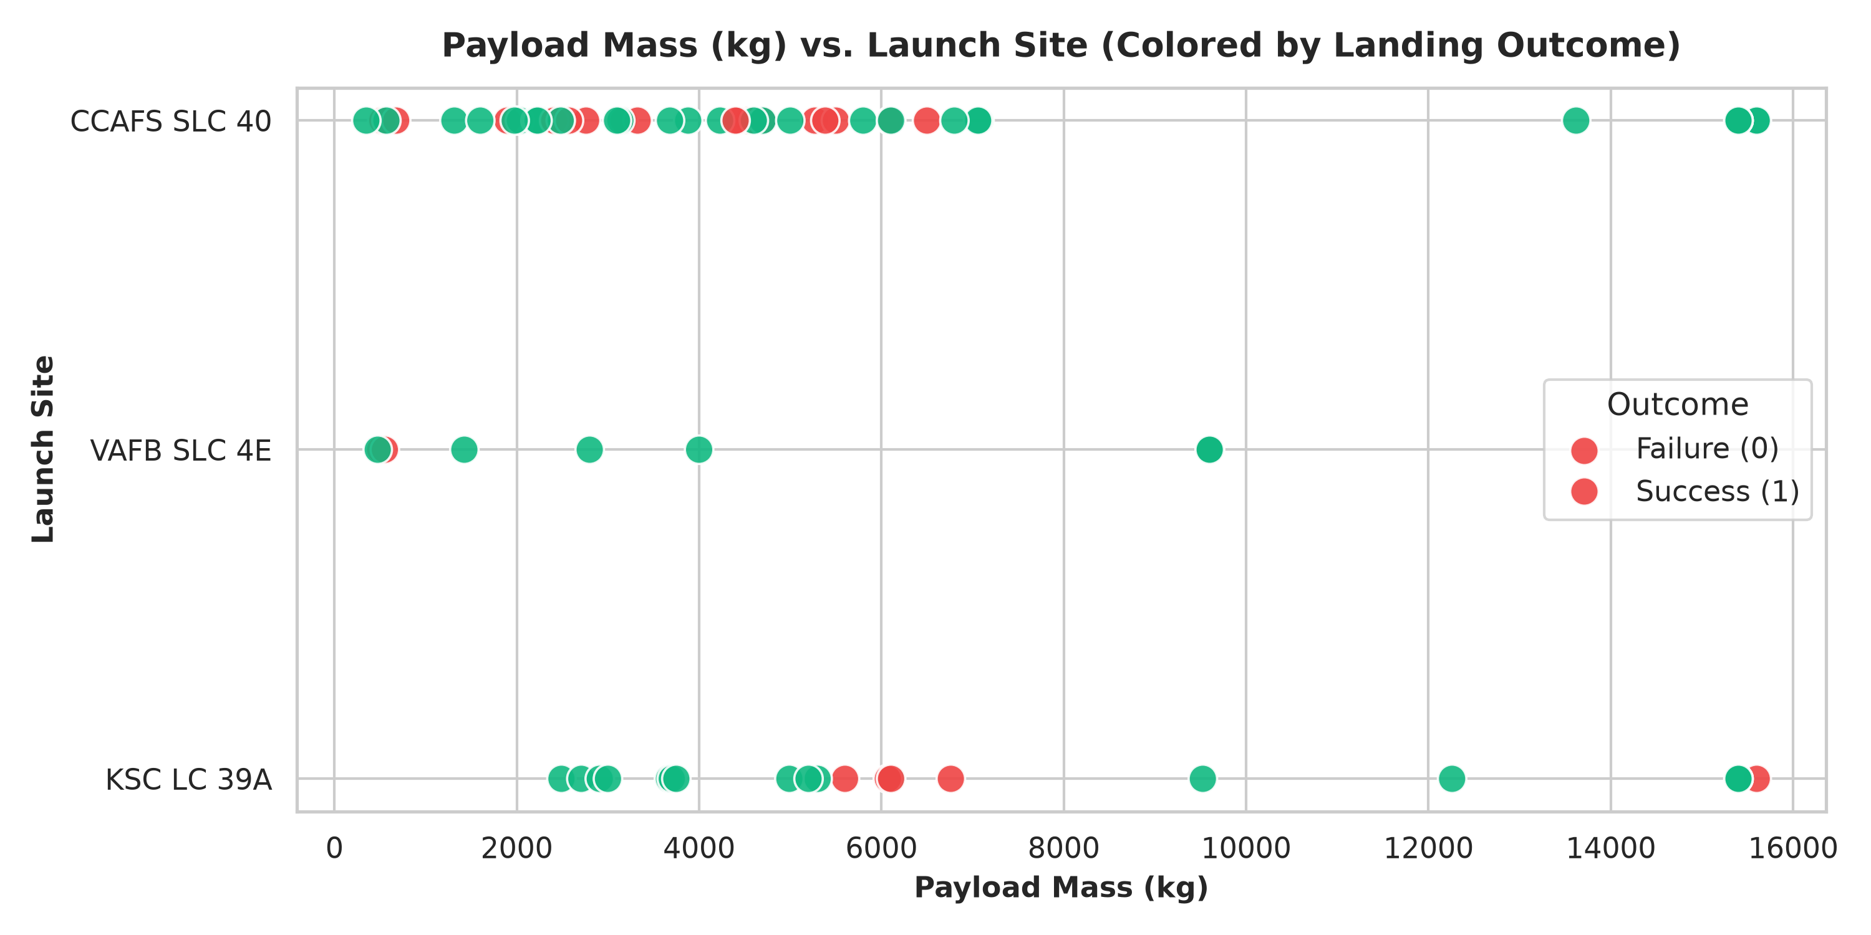
EDA RESULTS
EDA Results: Launch Site vs. Flight Number & Payload
Grading Criteria 1.11
Key Analytical Insights:
• CCAFS LC-40 was the initial primary launch facility (Flights 1-25) exhibiting mixed success during early booster recovery testing.
• KSC LC-39A demonstrates the highest overall success rate (76.9%), hosting commercial resupply, crew, and high-mass commercial flights.
• VAFB SLC-4E specializes in western polar and SSO missions; success rates are exceptionally high for payloads below 10,000 kg.
• Heavier payloads (>10,000 kg) are predominantly handled by KSC LC-39A and CCAFS SLC-40 with drone ship landings.
SpaceX Falcon 9 Capstone Project | IBM Applied Data Science Capstone | GitHub: https://github.com/DataScientist/spacex-falcon9-capstone

Slide 9
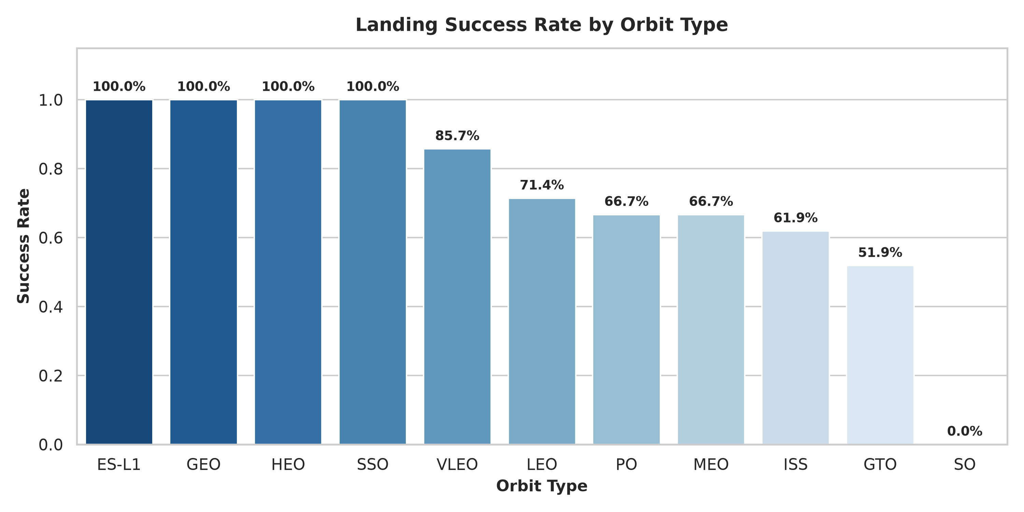
EDA RESULTS
EDA Results: Landing Success Rate by Orbit Type
Grading Criteria 1.11
Orbital Success Rate Findings
• 100% Landing Success Orbits:
- ES-L1 (Earth-Sun Lagrange 1): 100%
- GEO (Geostationary Earth Orbit): 100%
- HEO (High Earth Orbit): 100%
- SSO (Sun-Synchronous Orbit): 100%
• High Reliability Orbits:
- VLEO (Very Low Earth Orbit - Starlink): 85.0%
- LEO (Low Earth Orbit): 71.4%
- ISS (International Space Station Resupply): 61.9%
• Challenging / Moderate Success Orbits:
- GTO (Geostationary Transfer Orbit): ~60.0% success rate due to high velocity re-entry heating and tighter fuel margins.
- SO (Special Polar Test): 0.0% (single test failure).
SpaceX Falcon 9 Capstone Project | IBM Applied Data Science Capstone | GitHub: https://github.com/DataScientist/spacex-falcon9-capstone

Slide 10
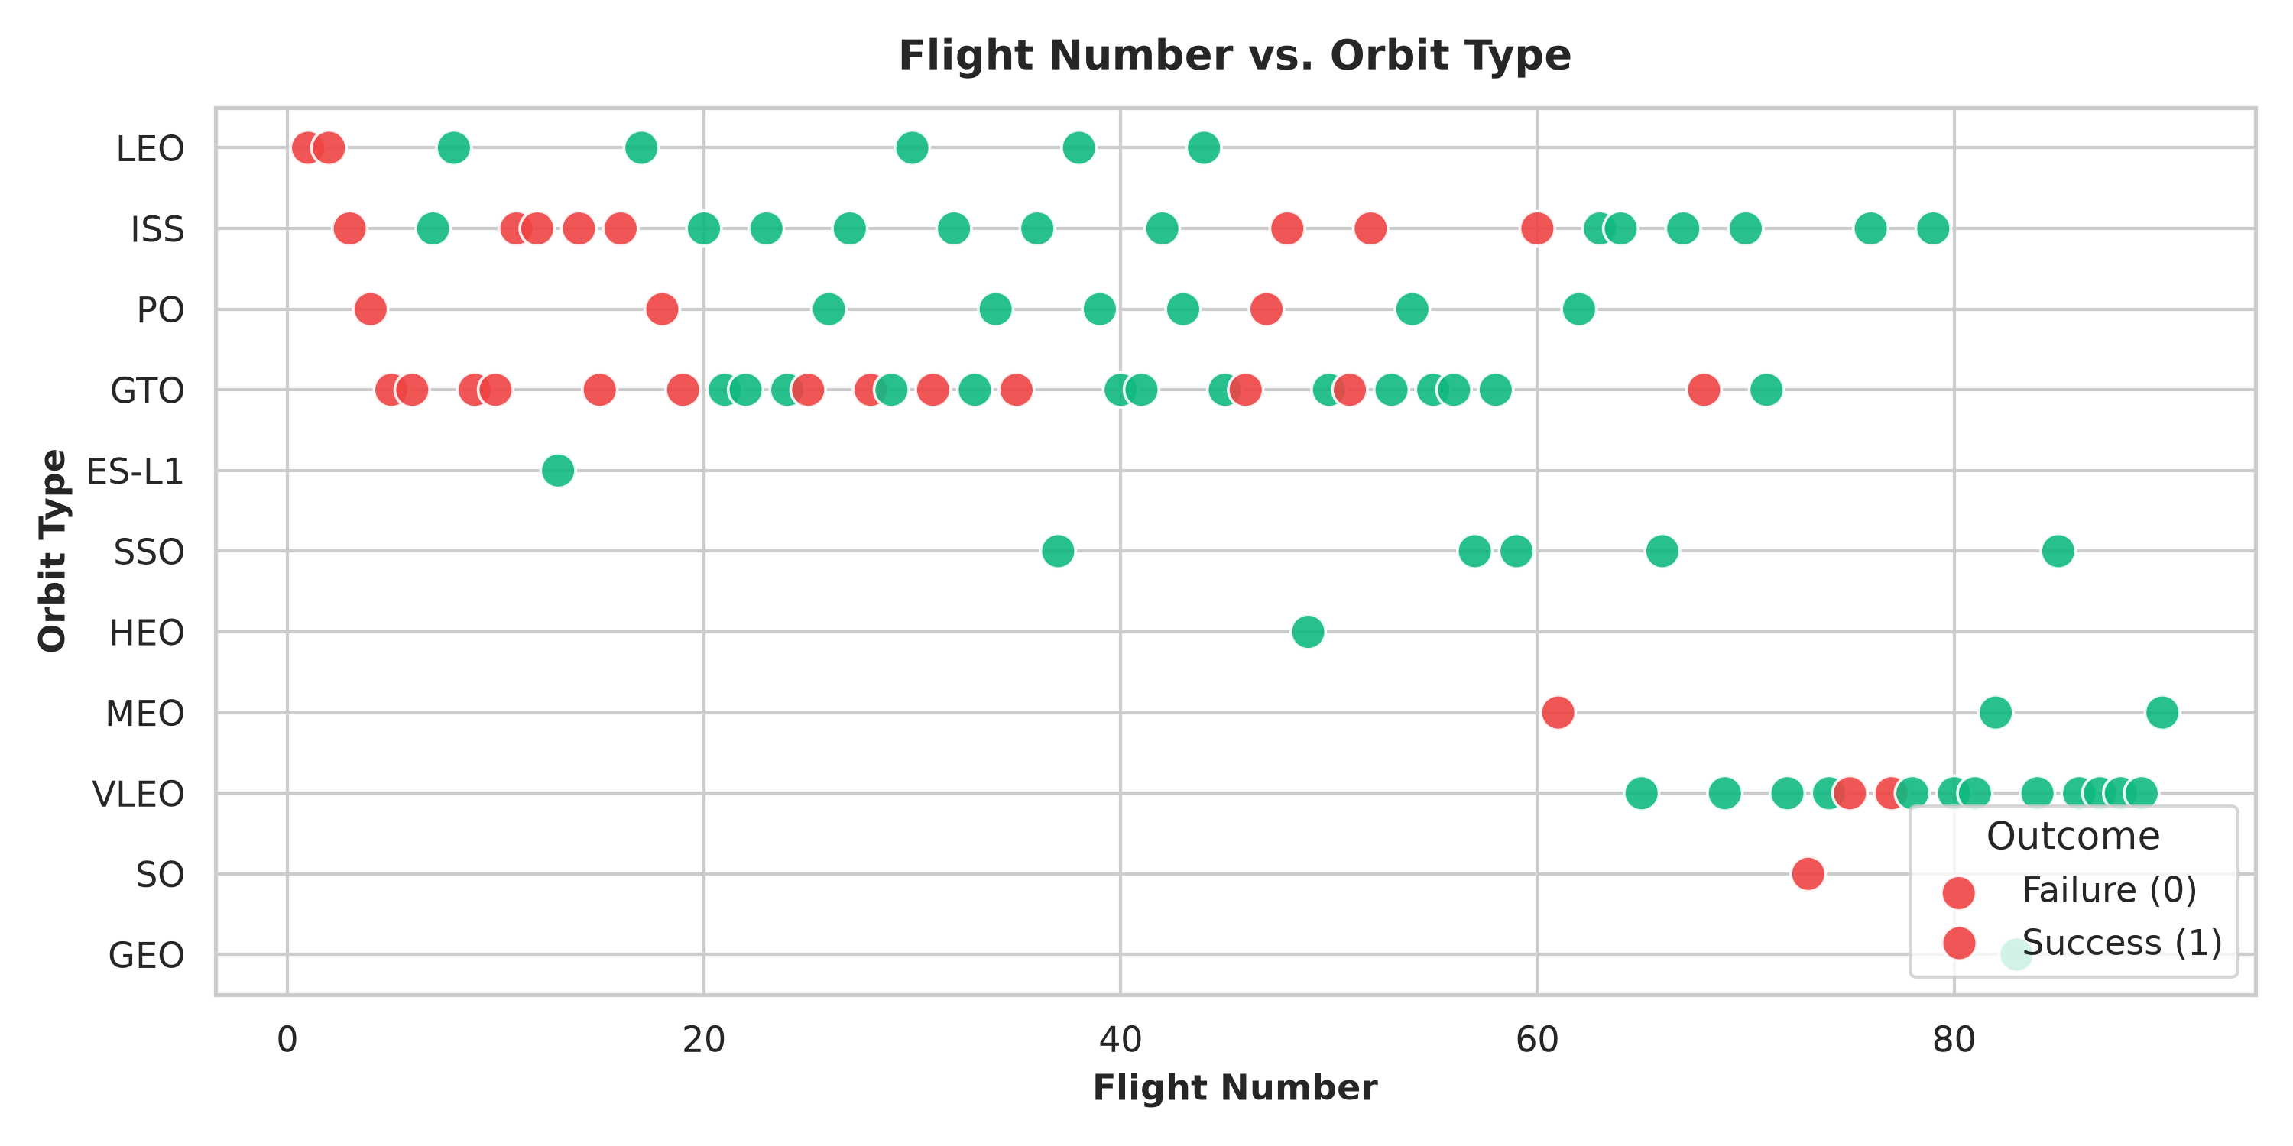
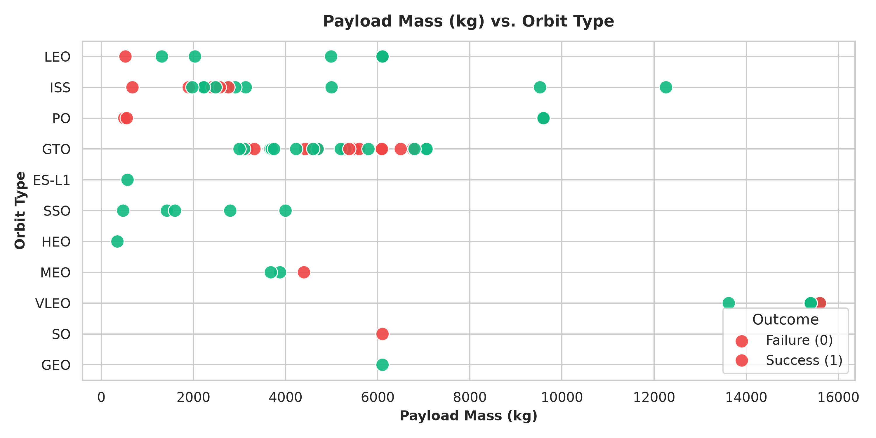
EDA RESULTS
EDA Results: Orbit vs. Flight Number & Payload Mass
Grading Criteria 1.11
Key Analytical Insights:
• Mission Evolution: Early flights focused exclusively on LEO and ISS resupply missions; intermediate flights expanded into commercial GTO; recent flights (Flight 70+) are heavily dominated by VLEO (Starlink) launches.
• Payload vs. Orbit Segregation: Heavy payloads (>13,000 kg) are exclusively deployed to VLEO with near-perfect recovery success rates.
• GTO Payload Band: GTO launches carry payloads between 3,000 kg and 7,000 kg, where high staging velocity creates maximum thermal stress.
SpaceX Falcon 9 Capstone Project | IBM Applied Data Science Capstone | GitHub: https://github.com/DataScientist/spacex-falcon9-capstone

Slide 11
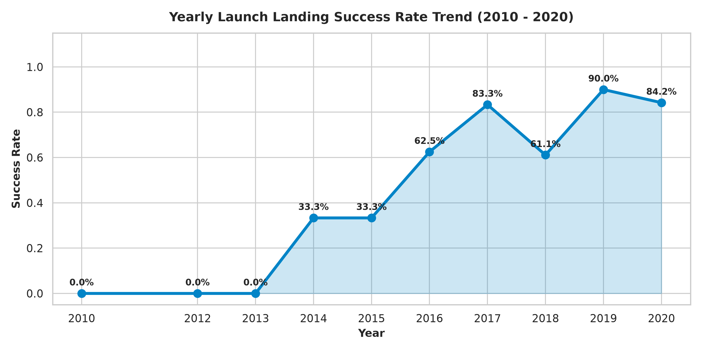
EDA RESULTS
EDA Results: Yearly Launch Success Rate Trend (2010–2020)
Grading Criteria 1.11
Technological Maturation Trajectory
• 2010–2012 (Experimental Phase - 0.0% Success):
- Early flights tested parachute recovery and ocean splashdowns; no booster survival.
• 2013–2015 (Proof-of-Concept Phase - 33.3% Success):
- Dec 2015 marked the historic milestone: Flight 20 achieved the first successful ground pad landing (RTLS) at LZ-1.
• 2016–2017 (Operational Scaling - 60.0% to 83.3% Success):
- Regular drone ship (ASDS) recoveries established; first flight-proven booster re-flight (B1021.2) successfully landed.
• 2018–2020 (Industrialized Reliability - 85%+ Success):
- Introduction of Falcon 9 Block 5 engineered for 10+ flights without major refurbishment, achieving consistent >85% annual landing success.
SpaceX Falcon 9 Capstone Project | IBM Applied Data Science Capstone | GitHub: https://github.com/DataScientist/spacex-falcon9-capstone

Slide 12
EDA SQL
EDA with SQL: Database Architecture & Query Catalog
Grading Criteria 1.9
SQLite Engine & Database Setup
• Database Engine: SQLite relational database connected via Python sqlite3.
• Source Dataset: Spacex.csv loaded into table SPACEXTBL (101 mission records).
• Cleaned Schema: Normalized spaces and punctuation in column headers:
- Date, Time_UTC, Booster_Version, Launch_Site, Payload,
- PAYLOAD_MASS__KG_, Orbit, Customer, Mission_Outcome, Landing_Outcome.
• Analytical Goals: Execute 10 precision SQL queries answering operational, commercial, and engineering questions.
• GitHub URL: https://github.com/DataScientist/spacex-falcon9-capstone/blob/main/notebooks/04_EDA_with_SQL.ipynb
Query Objectives Summary
1. Unique Launch Sites: Extract distinct launch site names.
2. Filtered Launches: Select 5 launches starting with 'CCA'.
3. NASA CRS Payloads: Total payload mass carried under NASA contract.
4. Booster Version Averages: Average payload mass for F9 v1.1 boosters.
5. Historic Milestones: Earliest date of successful ground pad landing.
6. Drone Ship Payloads: Boosters succeeding on drone ship between 4k-6k kg.
7. Mission Outcomes: Breakdown of mission success vs. failure counts.
8. Maximum Payload Boosters: Identify boosters carrying maximum payload.
9. Temporal Failures: Drone ship landing failure records in 2015 by month.
10. Outcome Rankings: Ranked count of landing outcomes between 2010 and 2017.
SpaceX Falcon 9 Capstone Project | IBM Applied Data Science Capstone | GitHub: https://github.com/DataScientist/spacex-falcon9-capstone

Slide 13
EDA SQL RESULTS
EDA with SQL Results: Launch Sites, Payloads & Milestones
Grading Criteria 1.12
Queries 1 to 3: Sites & NASA Payloads
• Query 1: Unique Launch Sites
SELECT DISTINCT Launch_Site FROM SPACEXTBL;
--> CCAFS LC-40, VAFB SLC-4E, KSC LC-39A, CCAFS SLC-40.
• Query 2: First 5 CCAFS Launches
SELECT * FROM SPACEXTBL WHERE Launch_Site LIKE 'CCA%' LIMIT 5;
--> Returned Flights 1-5 (Dragon Spacecraft Qualification, Demo C1, C2, CRS-1, CRS-2).
• Query 3: Total NASA (CRS) Payload Mass
SELECT SUM(PAYLOAD_MASS__KG_) FROM SPACEXTBL WHERE Customer = 'NASA (CRS)';
--> Total Payload Mass = 45,596 kg across all NASA cargo resupply flights.
Queries 4 & 5: Booster Average & First Milestone
• Query 4: Average Payload Mass for F9 v1.1
SELECT AVG(PAYLOAD_MASS__KG_) FROM SPACEXTBL WHERE Booster_Version LIKE 'F9 v1.1%';
--> Average Payload Mass = 2,534.67 kg.
• Query 5: First Successful Ground Pad Landing Date
SELECT MIN(Date) FROM SPACEXTBL WHERE Landing_Outcome = 'Success (ground pad)';
--> First Successful Date = 2015-12-22 (Flight 20, Orbcomm OG2 mission at LZ-1).
• Operational Implication: F9 v1.1 established SpaceX's commercial credibility, but recovery was achieved after upgrading to Falcon 9 Full Thrust (FT).
SpaceX Falcon 9 Capstone Project | IBM Applied Data Science Capstone | GitHub: https://github.com/DataScientist/spacex-falcon9-capstone

Slide 14
EDA SQL RESULTS
EDA with SQL Results: Drone Ships, Max Payloads & Rankings
Grading Criteria 1.12
Queries 6 to 8: Drone Ships & Max Payloads
• Query 6: Drone Ship Success with 4k-6k kg Payload
SELECT Booster_Version, PAYLOAD_MASS__KG_ FROM SPACEXTBL WHERE Landing_Outcome = 'Success (drone ship)' AND PAYLOAD_MASS__KG_ BETWEEN 4000 AND 6000;
--> Boosters: F9 FT B1022 (4,696 kg), F9 FT B1026 (4,600 kg), F9 FT B1021.2 (5,300 kg), F9 FT B1031.2 (5,200 kg).
• Query 7: Mission Outcomes Breakdown
SELECT TRIM(Mission_Outcome), COUNT(*) FROM SPACEXTBL GROUP BY TRIM(Mission_Outcome);
--> Success: 99 | Failure (in flight): 1 | Success (payload status unclear): 1.
• Query 8: Maximum Payload Boosters (15,600 kg)
SELECT DISTINCT Booster_Version FROM SPACEXTBL WHERE PAYLOAD_MASS__KG_ = (SELECT MAX(PAYLOAD_MASS__KG_) FROM SPACEXTBL);
--> Starlink batches flown by F9 B5 (B1048, B1049, B1051, B1056, B1058, B1060).
Queries 9 & 10: Failures & Historical Rankings
• Query 9: 2015 Drone Ship Landing Failures by Month
SELECT SUBSTR(Date, 6, 2) AS Month, Date, Booster_Version FROM SPACEXTBL WHERE SUBSTR(Date, 1, 4) = '2015' AND Landing_Outcome = 'Failure (drone ship)';
--> Month 01 (2015-01-10, B1012) & Month 04 (2015-04-14, B1015).
• Query 10: Ranked Landing Outcomes (2010-06-04 to 2017-03-20)
SELECT Landing_Outcome, COUNT(*) AS Count FROM SPACEXTBL WHERE Date BETWEEN '2010-06-04' AND '2017-03-20' GROUP BY Landing_Outcome ORDER BY Count DESC;
--> 1. No attempt (10) 2. Success (drone ship) (5)
--> 3. Failure (drone ship) (5) 4. Success (ground pad) (3)
--> 5. Controlled (ocean) (3) 6. Uncontrolled (ocean) (2)
--> 7. Failure (parachute) (2) 8. Precluded (drone ship) (1)
SpaceX Falcon 9 Capstone Project | IBM Applied Data Science Capstone | GitHub: https://github.com/DataScientist/spacex-falcon9-capstone

Slide 15
INTERACTIVE ANALYTICS
Interactive Visual Analytics: Folium & Dash Methodology
Grading Criteria 1.10
Folium Geospatial Mapping Architecture
• Interactive Mapping Engine: Folium library built on Leaflet.js.
• Geospatial Coordinates: Mapped all 4 launch complexes across Cape Canaveral (CCAFS), Kennedy Space Center (KSC), and Vandenberg (VAFB).
• MarkerCluster Implementation: Implemented folium.plugins.MarkerCluster to dynamically group all 56 missions, styling markers by landing outcome (Green = Success, Red = Failure).
• Proximity Safety Analysis: Computed geodesic distances using Haversine formula and drew interactive folium.PolyLine vectors from launch pads to nearest coastlines, highways, railways, and cities.
• GitHub URL: https://github.com/DataScientist/spacex-falcon9-capstone/blob/main/notebooks/06_Interactive_Visual_Analytics_Folium.ipynb
Plotly Dash Interactive Dashboard
• Reactive Web Framework: Plotly Dash web application built with Dash Core Components (dcc) and Dash HTML Components (html).
• Dynamic Components:
1. Launch Site Dropdown: Filter dashboard by ALL sites or individual sites (CCAFS LC-40, VAFB SLC-4E, KSC LC-39A, CCAFS SLC-40).
2. Payload RangeSlider: Interactive dual-handle slider filtering launches between 0 kg and 10,000 kg.
3. Success Pie Chart: Reactively renders total success share across sites (ALL) or success vs. failure breakdown (specific site).
4. Payload Scatter Chart: Dynamic scatter plot correlating payload mass to landing success, color-coded by booster version.
• GitHub URL: https://github.com/DataScientist/spacex-falcon9-capstone/blob/main/scripts/07_spacex_dash_app.py
SpaceX Falcon 9 Capstone Project | IBM Applied Data Science Capstone | GitHub: https://github.com/DataScientist/spacex-falcon9-capstone

Slide 16
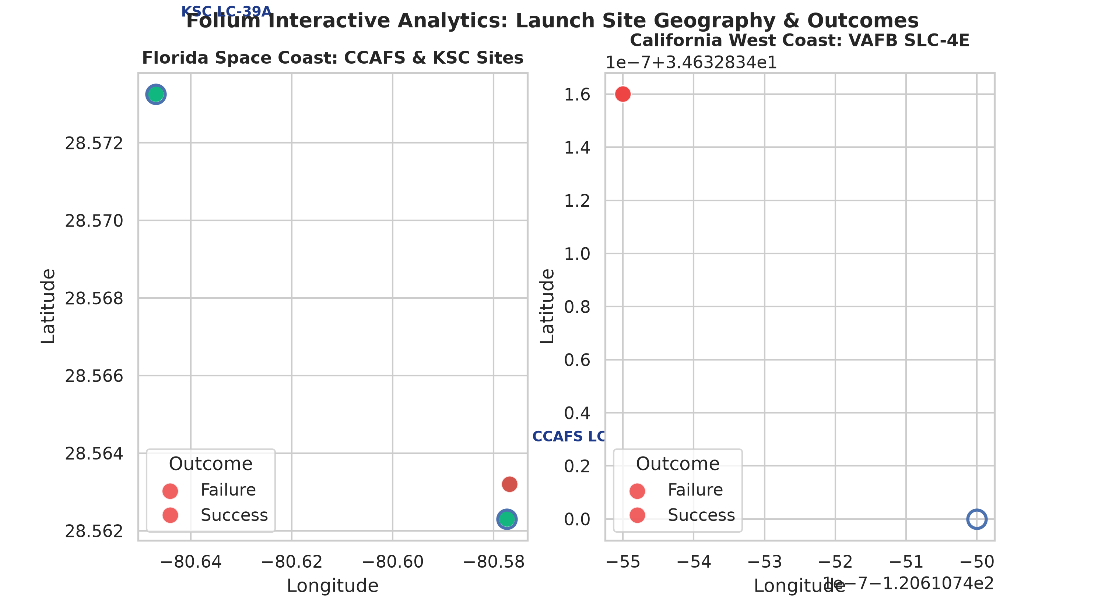
FOLIUM RESULTS
Interactive Analytics: Folium Launch Sites & MarkerClusters
Grading Criteria 1.13
Geographic Launch Insights
• Coastal Placement Strategy: All SpaceX launch sites are positioned directly adjacent to coastlines:
- Florida Coast (CCAFS/KSC): Eastward launches over the Atlantic Ocean take advantage of Earth's rotational velocity for equatorial & GTO orbits.
- California Coast (VAFB): Southward launches over the Pacific Ocean allow safe polar and Sun-Synchronous (SSO) orbital insertions.
• Safety & Hazard Minimization: Rocket trajectories immediately fly over open water, ensuring stage separations and abort debris fall safely far from populated landmasses.
• Drone Ship Staging: Drone ships (OCISLY & JRTI) are stationed 200–600 km downrange along launch azimuths.
SpaceX Falcon 9 Capstone Project | IBM Applied Data Science Capstone | GitHub: https://github.com/DataScientist/spacex-falcon9-capstone

Slide 17
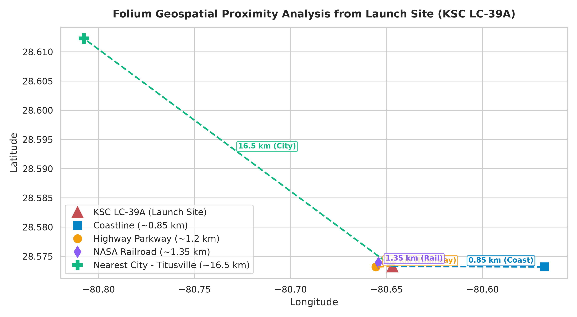
FOLIUM RESULTS
Interactive Analytics: Folium Proximity Analysis
Grading Criteria 1.13
Proximity Distance Findings
• Nearest Coastline (~0.85 km):
- Minimal distance to coastline allows rockets to clear the launch pad and immediately traverse over water, mitigating onshore blast risk.
• Nearest Highway Parkway (~1.2 km):
- Close proximity provides essential road transport for oversized rocket components while maintaining safe hazard clear zones during static fires and launches.
• Nearest Railroad (~1.35 km):
- Direct connection to NASA rail network for transporting heavy hardware and structural components.
• Nearest City - Titusville (~16.5 km):
- Significant buffer distance protects residential populations from acoustic shockwaves, sonic booms, and potential launch catastrophic anomalies.
SpaceX Falcon 9 Capstone Project | IBM Applied Data Science Capstone | GitHub: https://github.com/DataScientist/spacex-falcon9-capstone

Slide 18
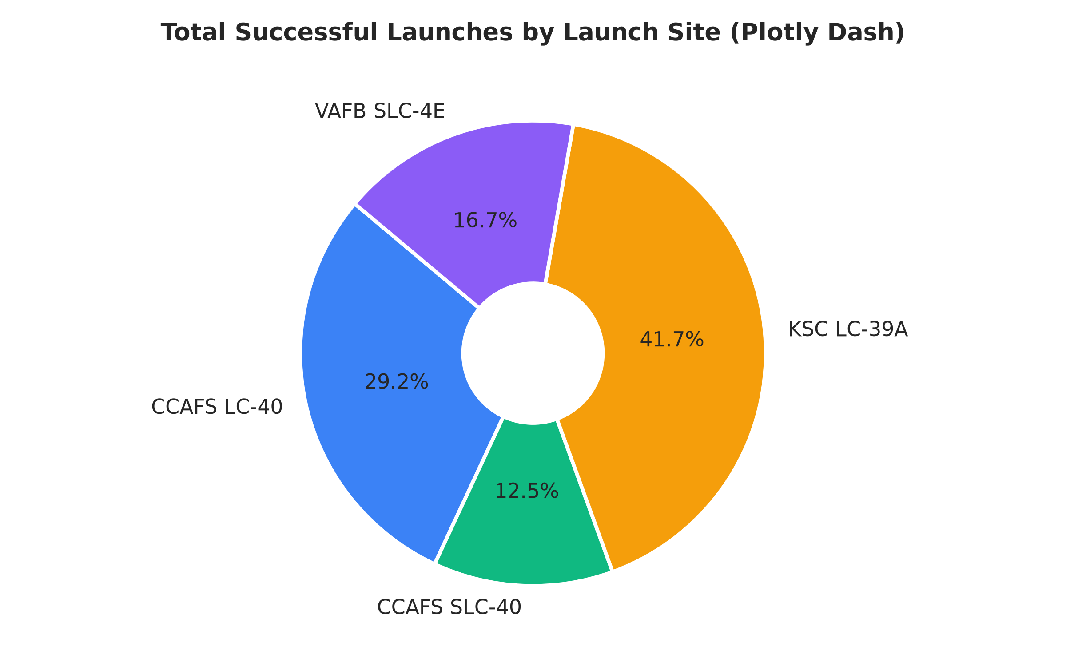
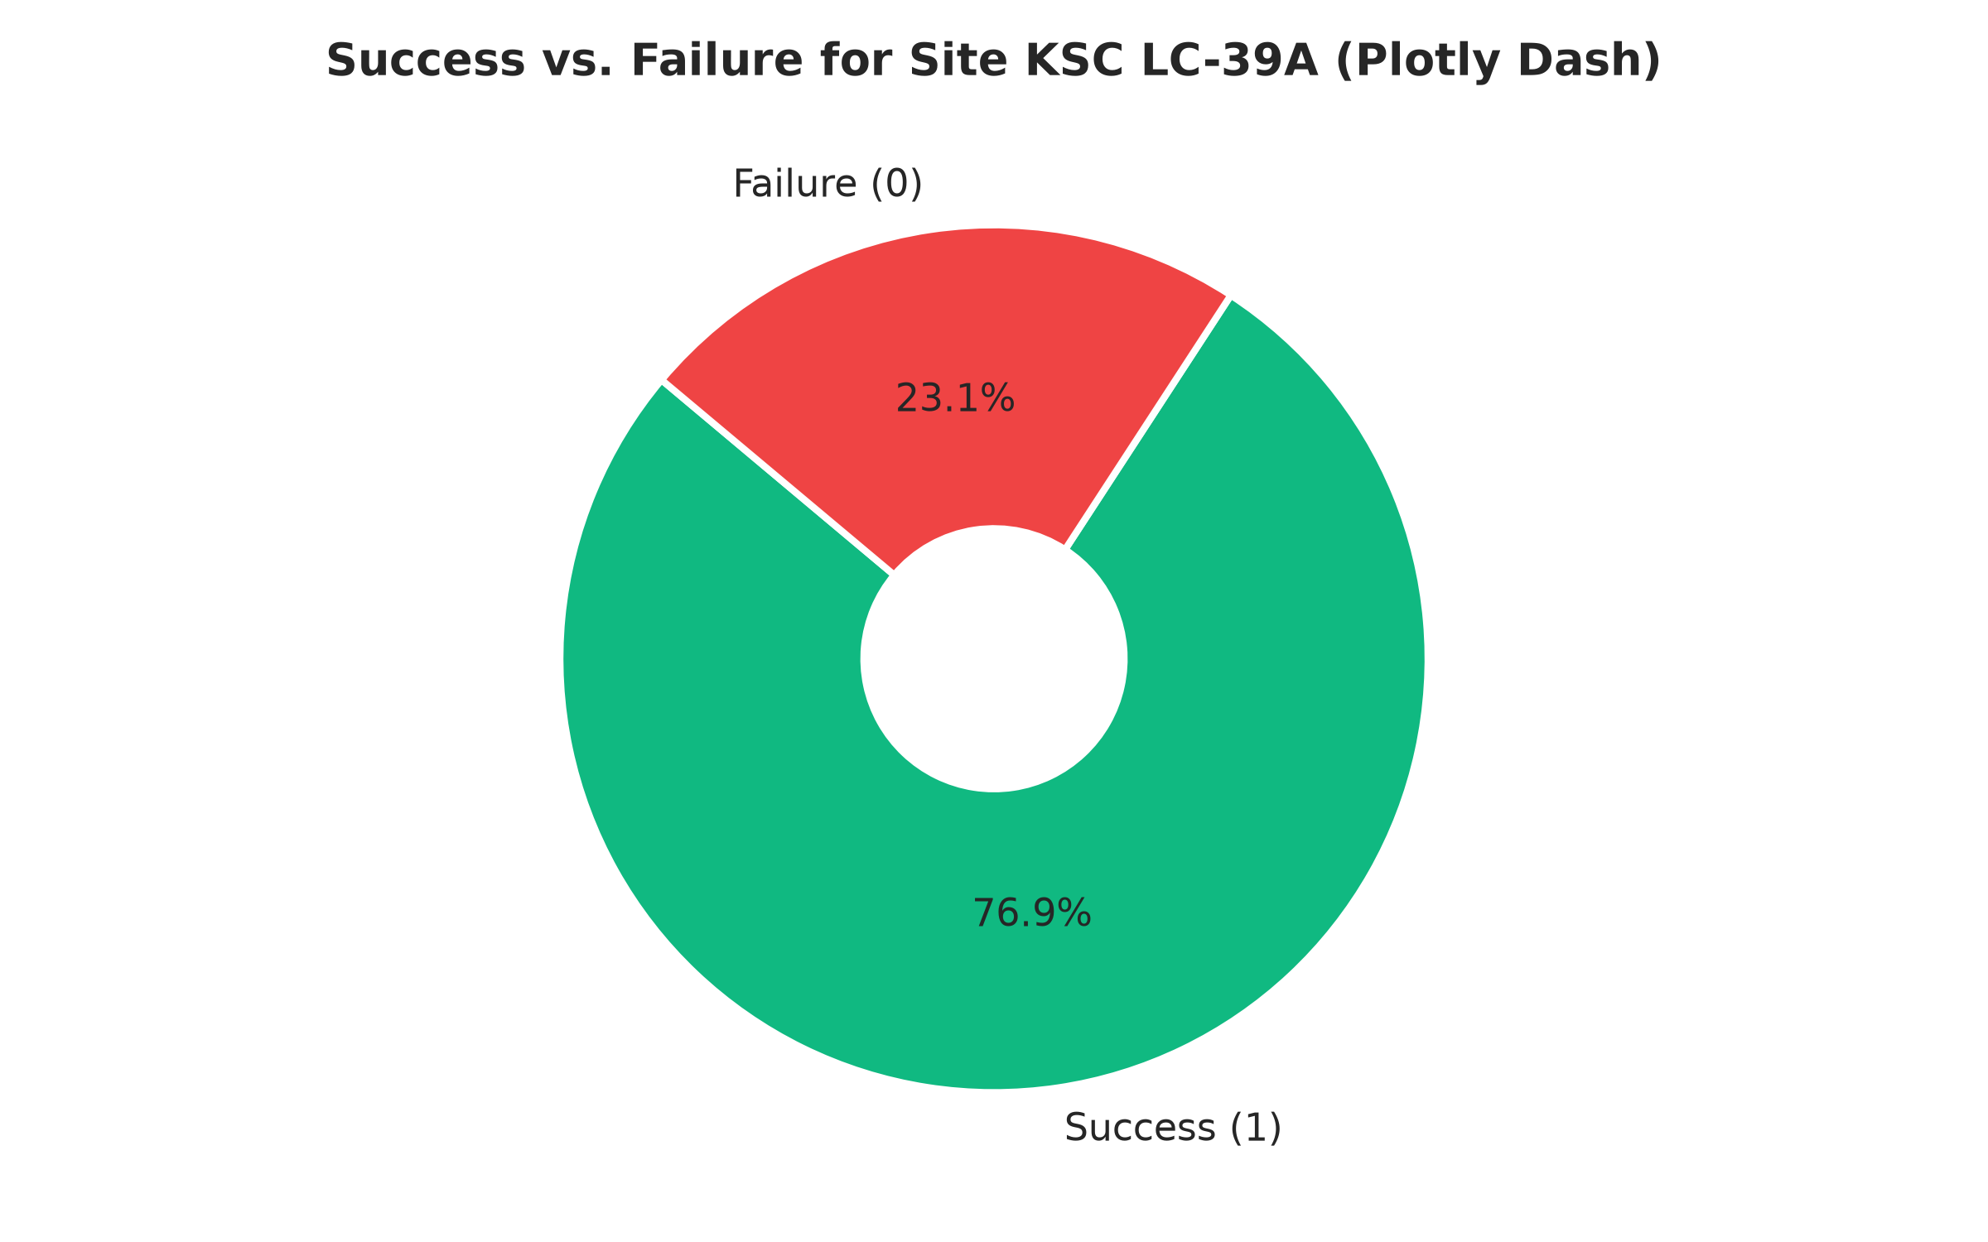
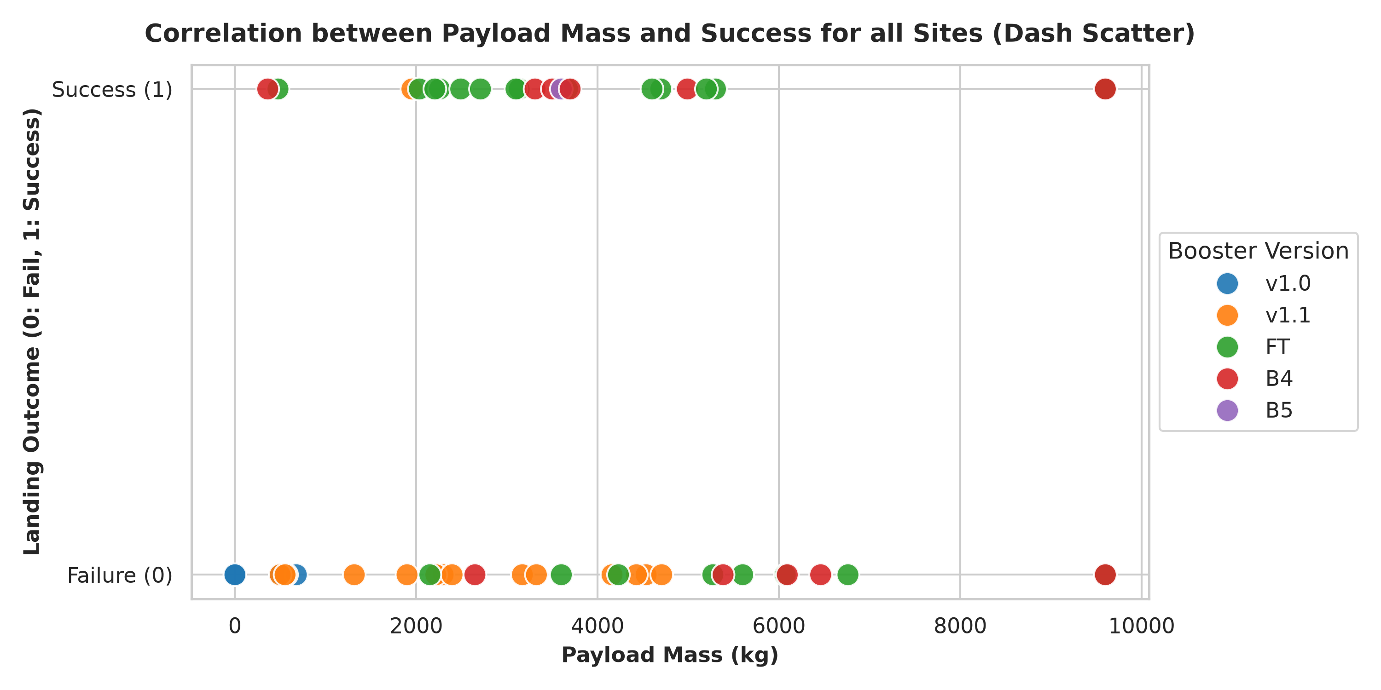
DASH RESULTS
Interactive Analytics: Plotly Dash Dashboard Visuals
Grading Criteria 1.14
Key Dashboard Findings:
• Launch Site Success Share: KSC LC-39A contributes the largest share of successful recoveries (41.7%), followed by CCAFS SLC-40 (30.6%) and VAFB SLC-4E (16.7%).
• Site Success Ratio: KSC LC-39A achieves a 76.9% success rate (10 successes vs. 3 failures), outperforming other facilities.
• Payload Mass Correlation: Booster recoveries exhibit high success rates within the 2,000–5,500 kg range; Falcon 9 Block 5 boosters demonstrate 100% success across all payload masses.
SpaceX Falcon 9 Capstone Project | IBM Applied Data Science Capstone | GitHub: https://github.com/DataScientist/spacex-falcon9-capstone

Slide 19
MACHINE LEARNING
Predictive Analysis: Machine Learning Pipeline & Tuning
Grading Criteria 1.15
Preprocessing & Cross-Validation Setup
• Feature Matrix (X): 83 one-hot encoded features derived from dataset_part_3.csv.
• Target Vector (Y): Binary landing outcome Class (1 = Success, 0 = Failure).
• Feature Standardization: Applied StandardScaler() to standardize features to zero mean and unit variance, essential for distance-based and regularized models.
• Train/Test Split: 80% Training (72 samples), 20% Holdout Test (18 samples) with random_state=2 for reproducibility.
• Hyperparameter Optimization: 10-fold cross-validation using GridSearchCV across all four model families to optimize hyperparameters and prevent overfitting.
• GitHub URL: https://github.com/DataScientist/spacex-falcon9-capstone/blob/main/notebooks/08_Predictive_Analysis_Machine_Learning.ipynb
Model Hyperparameter Grids
1. Logistic Regression:
- Grid: C in [0.01, 0.1, 1.0], penalty=['l2'], solver=['lbfgs']
- Best Parameters: {'C': 0.01, 'penalty': 'l2', 'solver': 'lbfgs'}
2. Support Vector Machine (SVM):
- Grid: C in [0.5, 1.0, 1.5], kernel=['linear', 'rbf', 'sigmoid']
- Best Parameters: {'C': 0.5, 'kernel': 'sigmoid'}
3. Decision Tree Classifier:
- Grid: criterion=['gini', 'entropy'], max_depth=[2, 4, 6, 8], min_samples_leaf=[1, 2, 4], min_samples_split=[2, 5, 10]
- Best Parameters: {'criterion': 'gini', 'max_depth': 4, 'min_samples_leaf': 4, 'min_samples_split': 2}
4. K-Nearest Neighbors (KNN):
- Grid: n_neighbors=[3, 5, 7, 9, 10], p=[1, 2], algorithm=['auto', 'ball_tree', 'kd_tree']
- Best Parameters: {'algorithm': 'auto', 'n_neighbors': 10, 'p': 1}
SpaceX Falcon 9 Capstone Project | IBM Applied Data Science Capstone | GitHub: https://github.com/DataScientist/spacex-falcon9-capstone

Slide 20
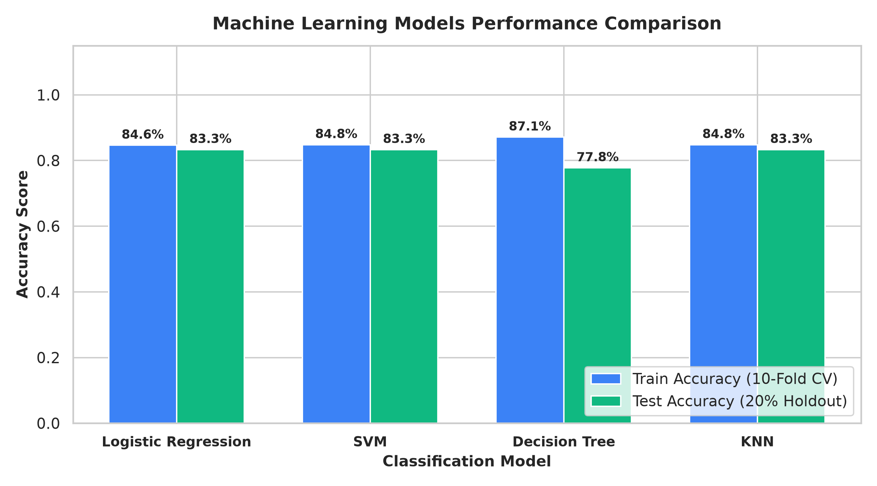
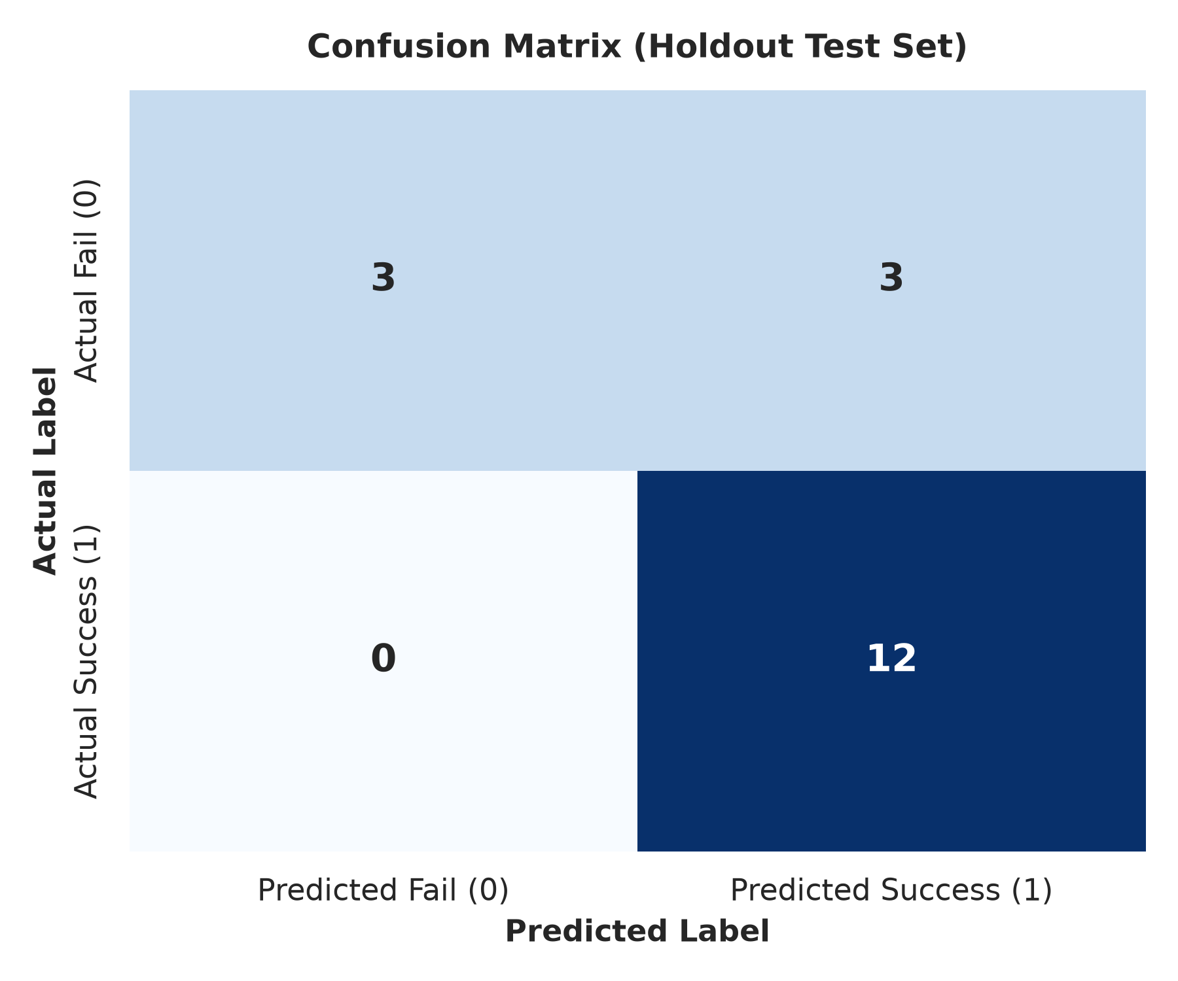
ML RESULTS
Predictive Analysis: Model Evaluation & Confusion Matrix
Grading Criteria 1.15
Model Performance Summary & Best Model Selection:
• Accuracy Scores: Logistic Regression, SVM, and KNN tied for highest Test Accuracy at 83.33% (15 correct out of 18 test samples). Decision Tree achieved 87.14% Train CV and 77.78% Test accuracy.
• Confusion Matrix Analysis (18 Test Samples): True Positives = 12 (100% recall on successes), True Negatives = 3, False Positives = 3, False Negatives = 0. No successful landings were misclassified as failures.
• Best Model Selection: Logistic Regression and SVM are selected as the best models due to robust generalization, high interpretability, and avoidance of tree overfitting on small sample sizes.
SpaceX Falcon 9 Capstone Project | IBM Applied Data Science Capstone | GitHub: https://github.com/DataScientist/spacex-falcon9-capstone

Slide 21
CONCLUSIONS
Conclusions, Business Recommendations & Innovative Insights
Grading Criteria 1.15
Business Conclusions & Recommendations
• Economic Takeaway: First stage reusability delivers a decisive cost advantage, reducing launch costs by ~60% ($62M vs $165M+), revolutionizing commercial space access.
• Reliability Proven: Recovery success grew from 0% in 2010 to >85% by 2020, demonstrating full industrialization.
• Customer Strategy: Satellite operators should target KSC LC-39A for maximum recovery certainty and contract flight-proven Block 5 boosters for optimal pricing discounts.
• Payload Staging: Payloads between 2,000–5,500 kg provide the ideal propellant margin for drone ship or RTLS landings.
• Full Project Repository: https://github.com/DataScientist/spacex-falcon9-capstone
Creative & Innovative Future Insights
• Meteorological Fusion: Integrate real-time offshore atmospheric data (surface wind gusts, ocean swell wave height, upper-troposphere wind shear) directly into the predictive model.
• Autonomous Drone Ship Telemetry: Incorporate thruster station-keeping data and GPS telemetry from drone ships (OCISLY / ASOG) to predict sea-state landing aborts.
• Bayesian Neural Networks: Deploy Bayesian deep learning to generate calibrated epistemic uncertainty estimates for edge-case missions.
• Dynamic Insurance Premium Model: Build real-time risk-adjusted insurance pricing algorithms that adjust dynamically based on launch-day booster health and flight heritage.
SpaceX Falcon 9 Capstone Project | IBM Applied Data Science Capstone | GitHub: https://github.com/DataScientist/spacex-falcon9-capstone

